Slide 1

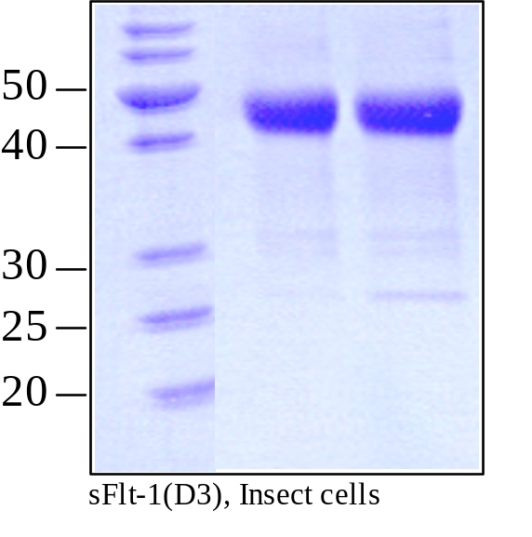
ReliaTech GmbH
Recombinant human soluble Flt-1 (D3)
(Cat #S01-015 / -016 )
Fig. 1: SDS-PAGE analysis of recombinant human soluble Flt-1 (D3). Samples were loaded in 15% SDS-polyacrylamide gel under reducing conditions and stained with Coomassie blue.
http://www.reliatech.de / orders@reliatech.de

